Slide 1


Cosmetics Store Management system
Rutuja Khakal​

Slide 2

Agenda
Introduction
Aim
Technology
Database Tables
Tables / Records
Queries
Conclusion

Slide 3

Cosmetics Store Management system

Slide 4

Introduction
This Cosmetics Store management system helps manage the daily operations of a cosmetics store.
The Cosmetic Store Management System is a SQL-based project designed for managing cosmetic store operations.
It allows storage and management of data related to products, customers, orders, and order items.
The system provides functionality to analyze sales, monitor stock levels, and calculate profits.

Slide 5
Aim
To create a system that efficiently manages the products, customers, and orders of a cosmetic store using a relational database.
To perform data analysis such as tracking sales, profits, and customer behavior using SQL queries.
This project helps manage the daily operations of a cosmetic store.
It keeps track of products, customers, and their orders.
We use SQL to store, retrieve, and analyze sales and profit
Data.

Slide 6
Technology
Database : MYSQL
Language : SQL
Tools used : MYSQL Workbench

Slide 7
Database Tables
In Cosmetics Store Management system has a Four tables.
Each tables has a 20 records.
Products: : Details of cosmetics.
Customers: : Customer information.
Orders: : Orders placed by customers.
OrderItems: : Products in each order.

Slide 8
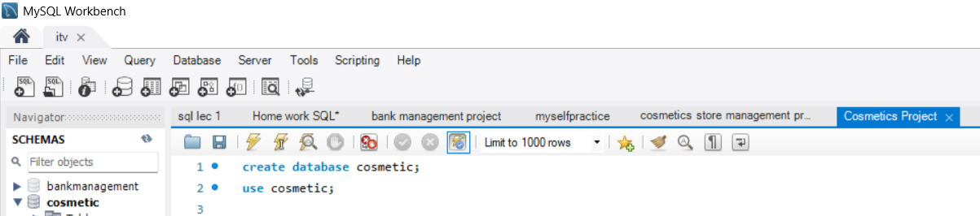
Create Database Use Database

Slide 9
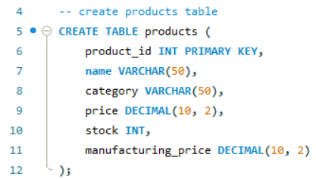
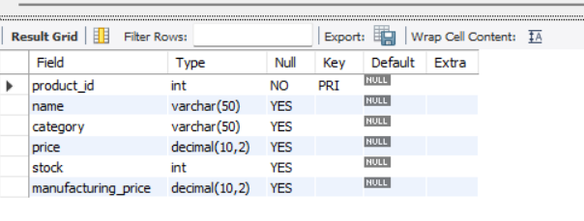
Create Products table :

Slide 10
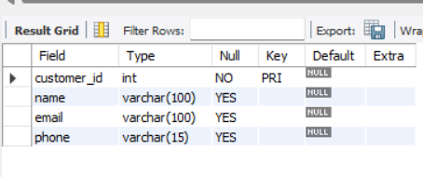
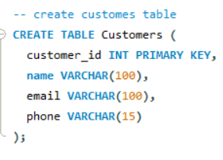
Create Customers table :

Slide 11
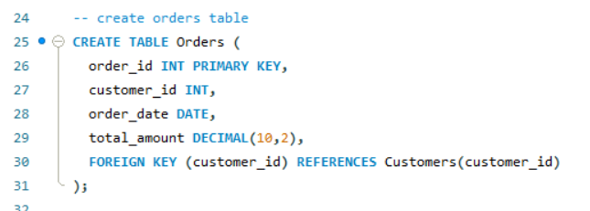
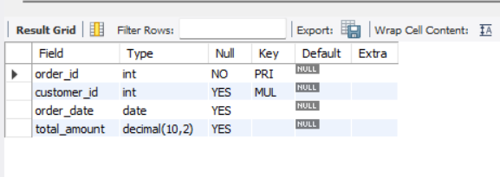
Create Orders table :

Slide 12
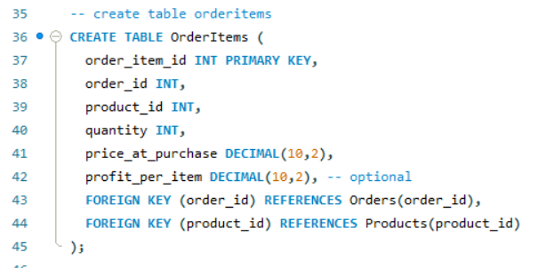
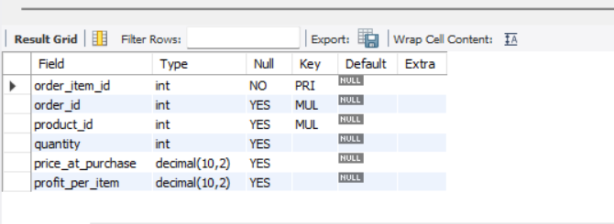
Create OrdersItems table :

Slide 13
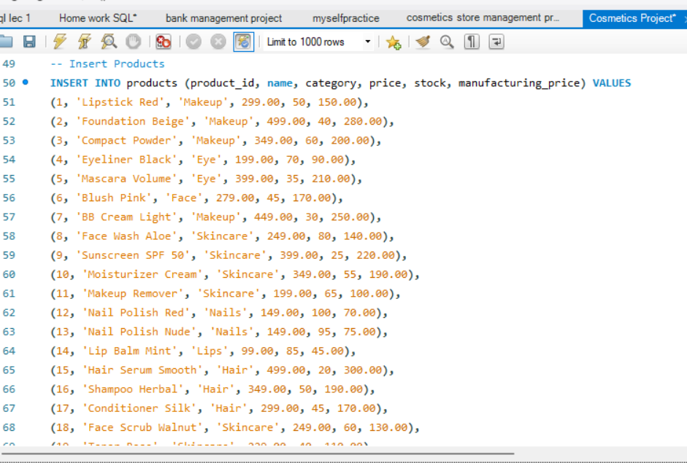
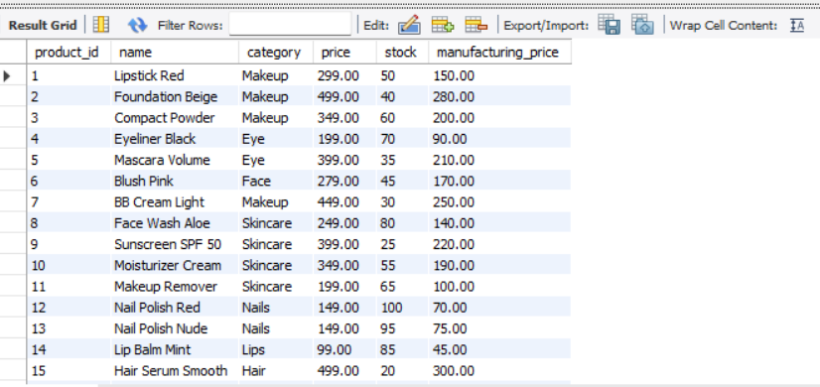
Insert Products

Slide 14
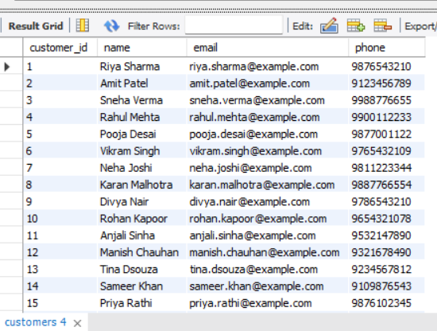
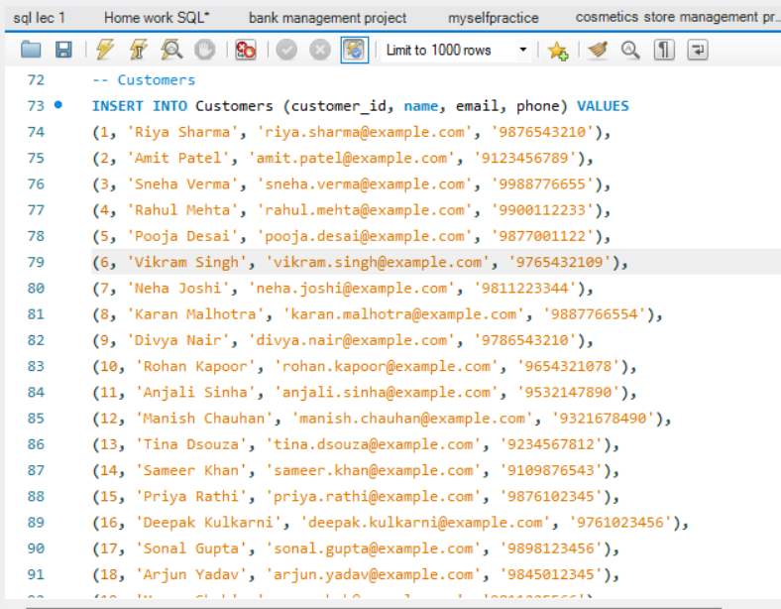
Insert Customers

Slide 15
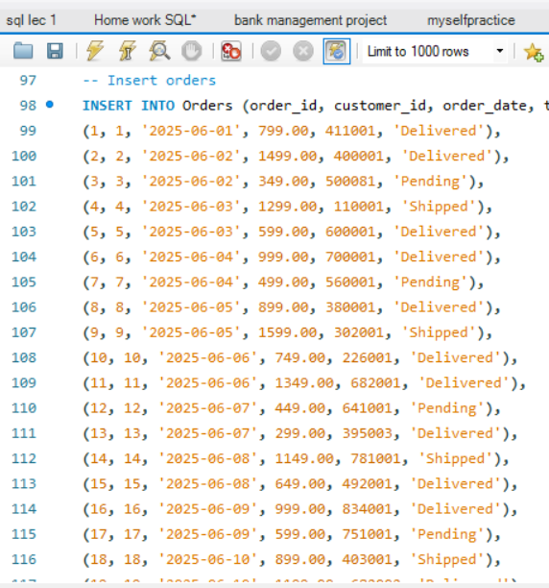
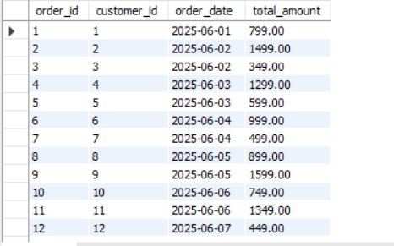
Insert Orders:

Slide 16
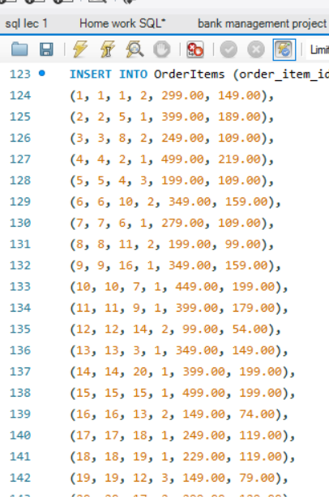
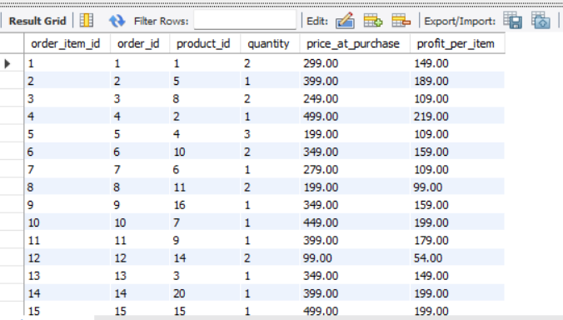
Insert OrdersItems :

Slide 17

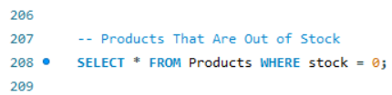
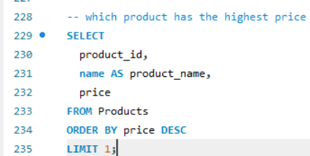
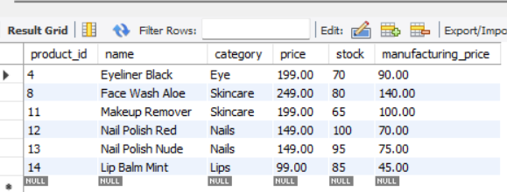
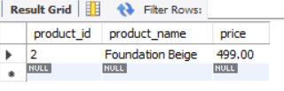

Slide 18
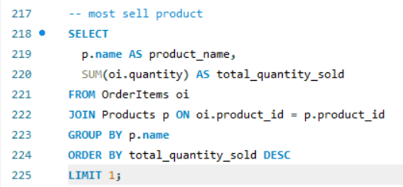
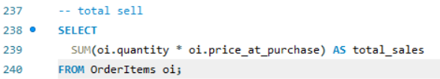
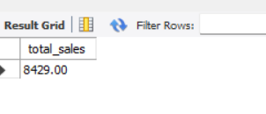
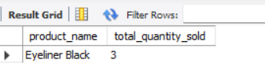

Slide 19
Conclusion :
The Cosmetic Store Management System project successfully demonstrates how SQL can be used to manage and analyze real-world business data.
It provides valuable insights into product performance, customer behavior, and profitability.
Through structured data storage and meaningful queries, the system helps track product performance, monitor customer activity, and measure profitability.

Slide 20
Thank you
Rutuja Khakal

